Slide 1
專論計畫
陳良政 方郁文

Slide 2
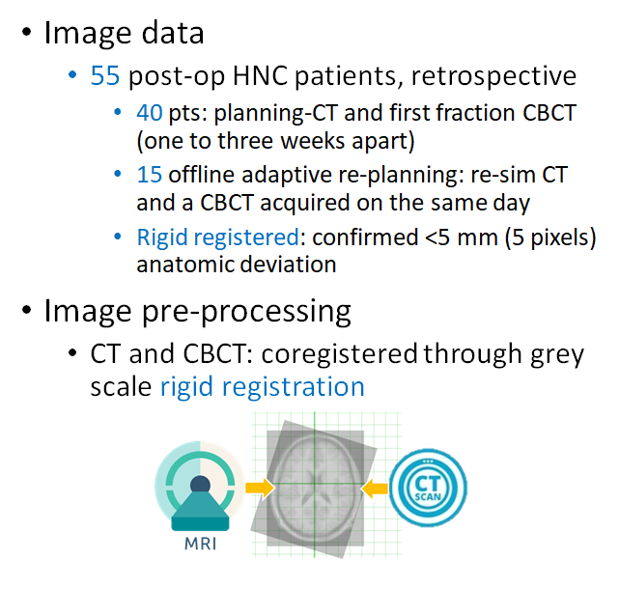
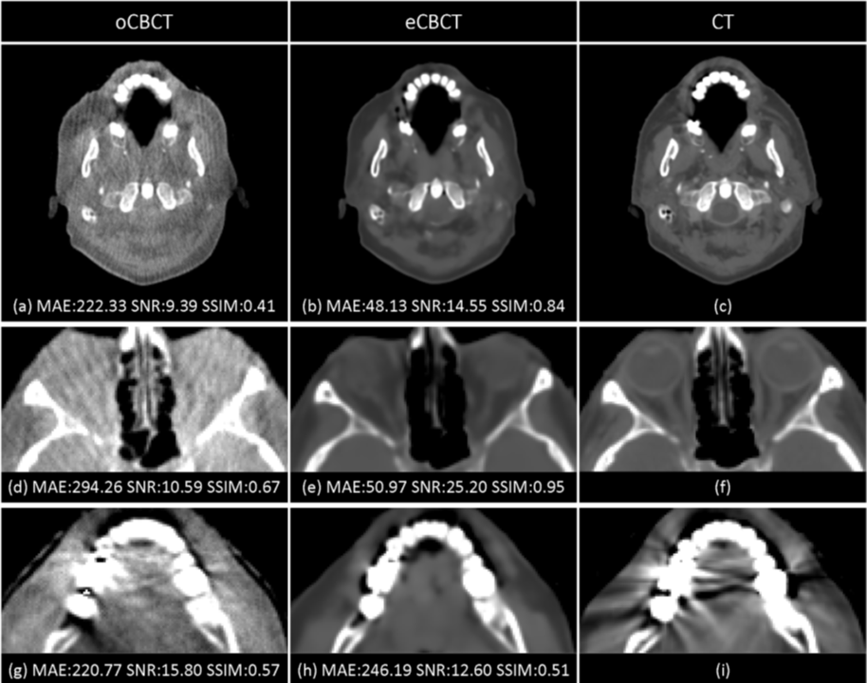
Original Paper
Phys Med Biol. 2020 Jan 27;65(3):035003. (Impact Factor: 3.03 )

Slide 3
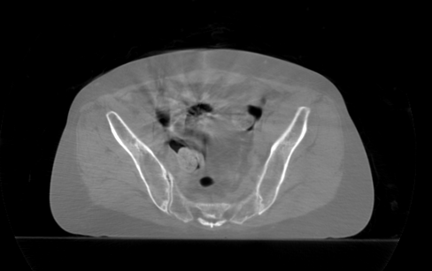
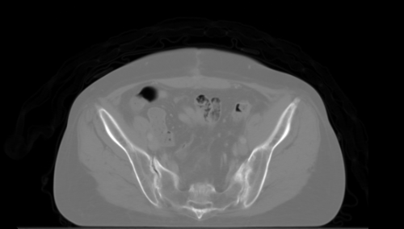
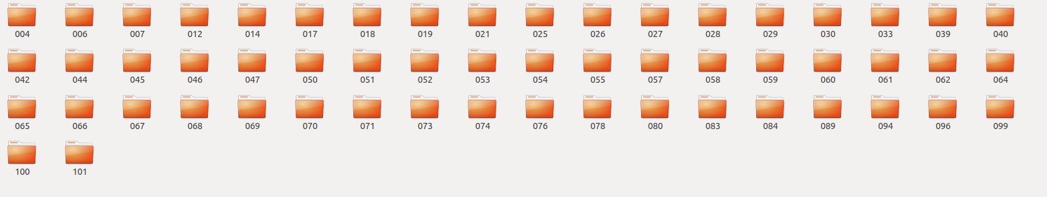
Problem: Apply on more difficult site-Pelvis
Data
Enhance Low Quality Cone Bean CT images with Deep Learning Methods
Goal is to remove artifacts, and the noises on CBCT images
60 CT series from Dalin Tzuchi
Can extract more than 1344 cbct/ct image pairs for training

Slide 4
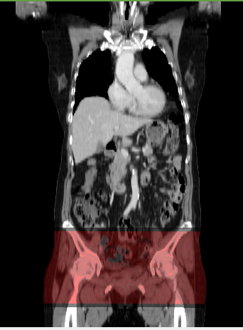
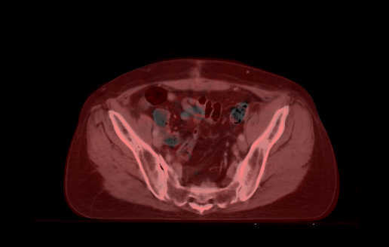
Registration
Image Registration and Match Window Size

Slide 5
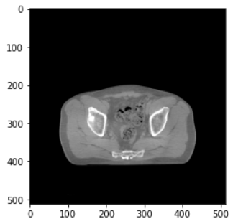
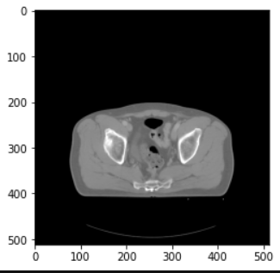
Extract Ct and Cbct pair
Extract Registrated CT and CBCT pair

Slide 6
Extract Ct and Cbct pair : How To
There isn’t a complete tutorial online on this topic
It may be important to keep a Step-by-Step tutorial on how to preprocess the data

Slide 7
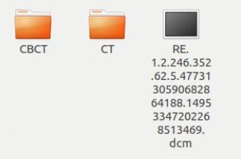
Data pair
A pair of data should look like this

Slide 8
Data pair
A pair of data should look like this
Registration file
Cone Beam CT slides
CT slides

Slide 9
Data pair
A pair of data should look like this
Note that Registration file is very important. Without applying registration on CT and CBCT pair, the training will not work
Registration file
Cone Beam CT slides
CT slides

Slide 10
Data pair
A pair of data should look like this
Note that Registration file is very important. Without applying registration on CT and CBCT pair, the training will not work
Registration file
Cone Beam CT slides
CT slides

Slide 11
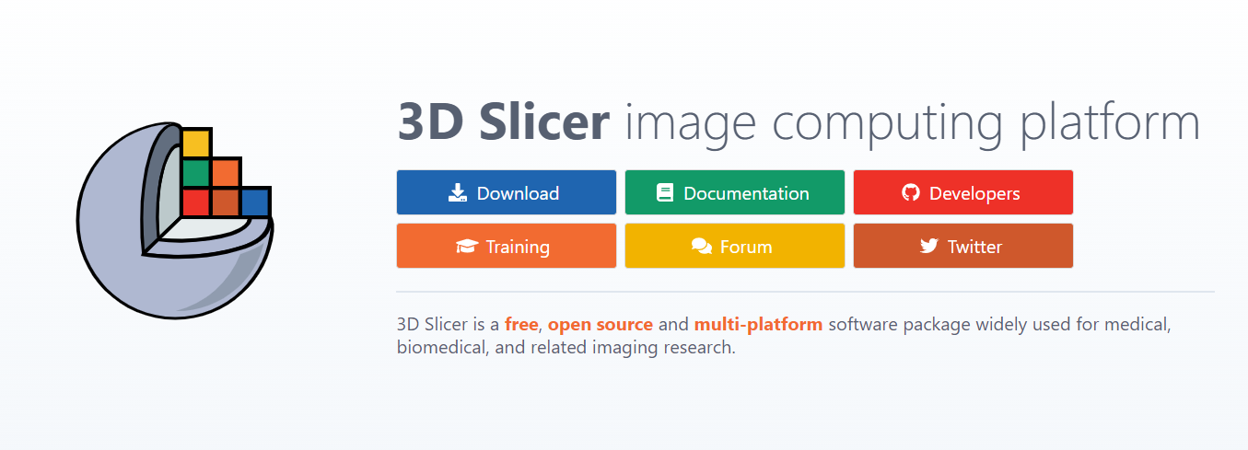
Processing utility

Slide 12
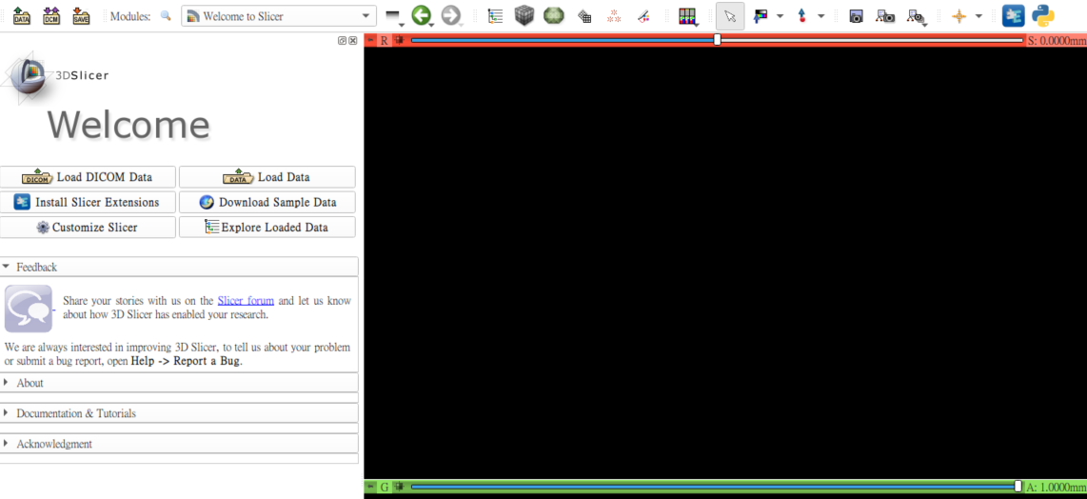
Open data with 3D Slicer
Click Load DICOM Data

Slide 13
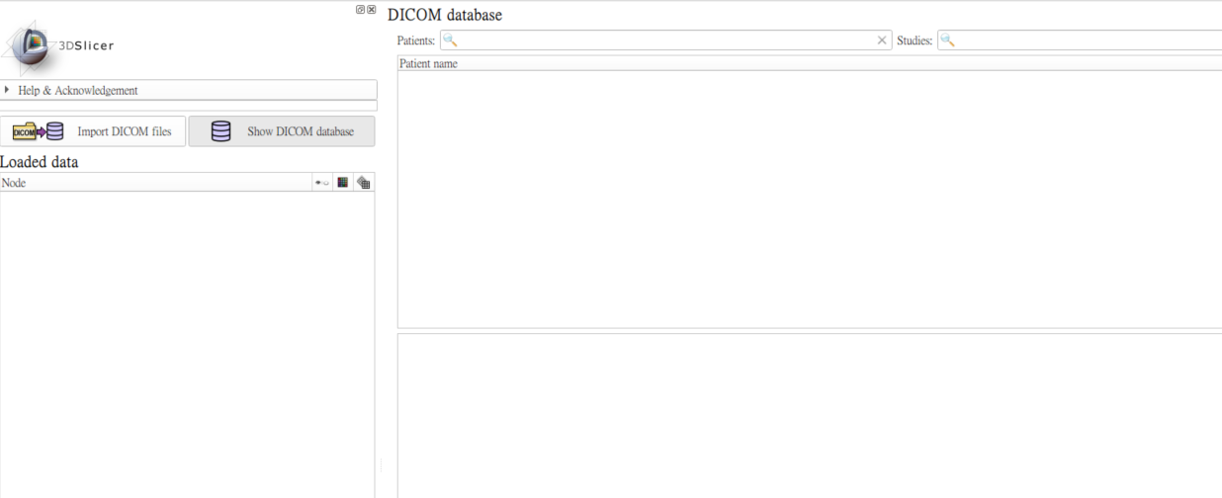
Open data with 3D Slicer
Click Import DICOM files

Slide 14
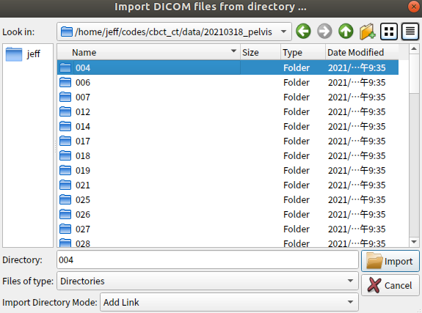
Open data with 3D Slicer
Select a case

Slide 15
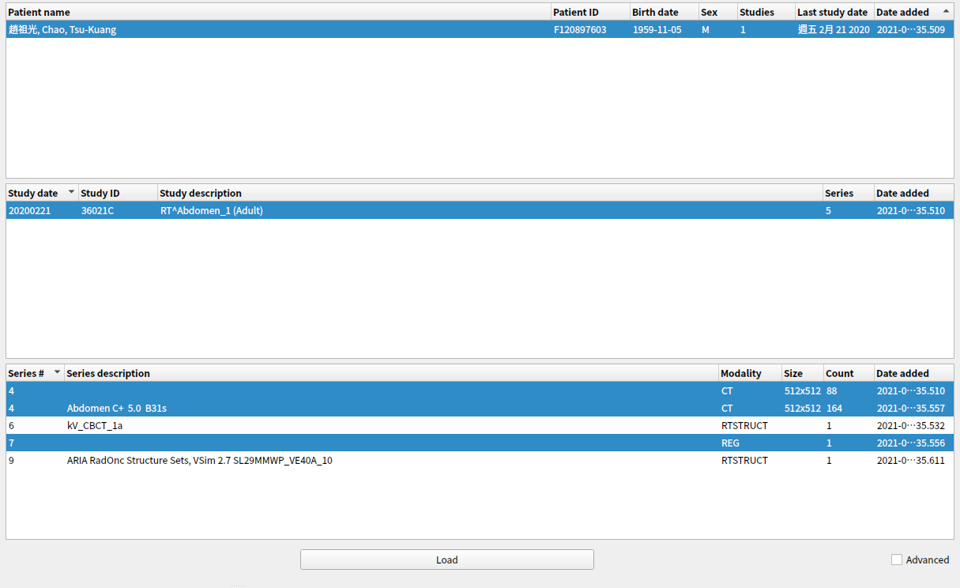
Open data with 3D Slicer
Select the two CT pair and the registration file

Slide 16
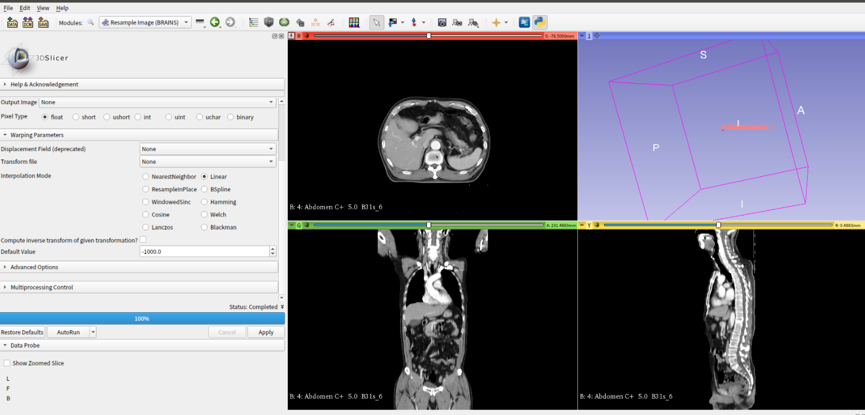
Apply registration
Moudles => Registration => Resample Image (BRAINS)

Slide 17
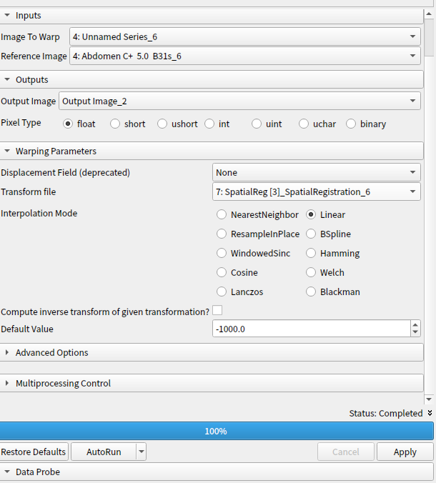
Apply registration
Use these settings:
Image To Warp: cbct
Reference Image: ct
Output Image: create new volumn
Transform file: the reg file
Default Value: -1000
Click Apply

Slide 18
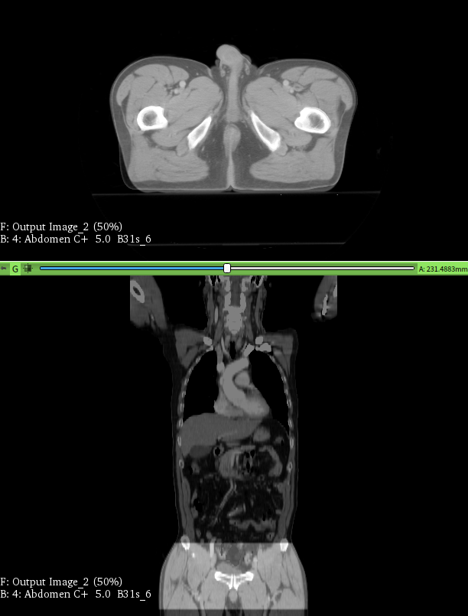
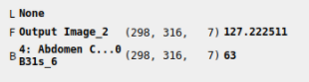
Registration done
the z axis should be the same

Slide 19
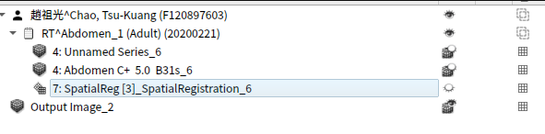
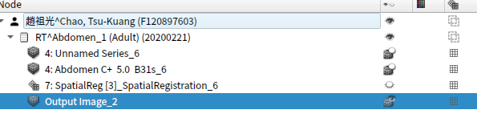
Save Transform result
Pull the registrated
slices under same patient

Slide 20
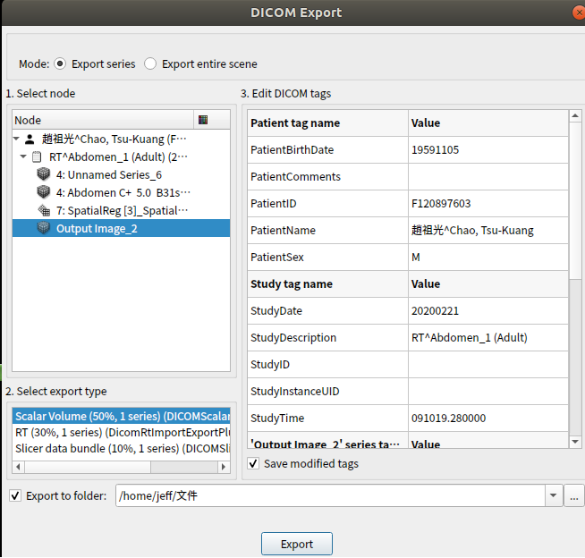
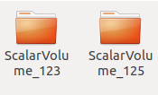
Save Transform result
right click on volumn =>
Export to DICOM

Slide 21
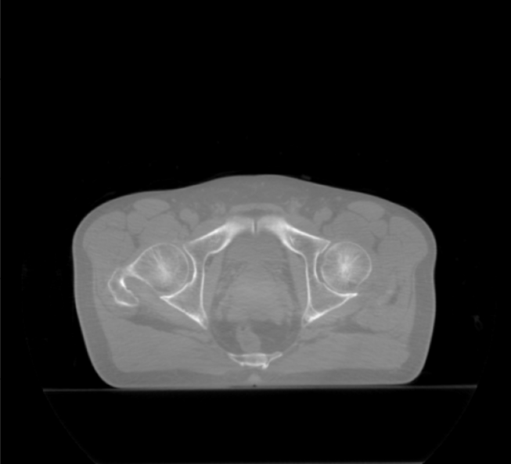
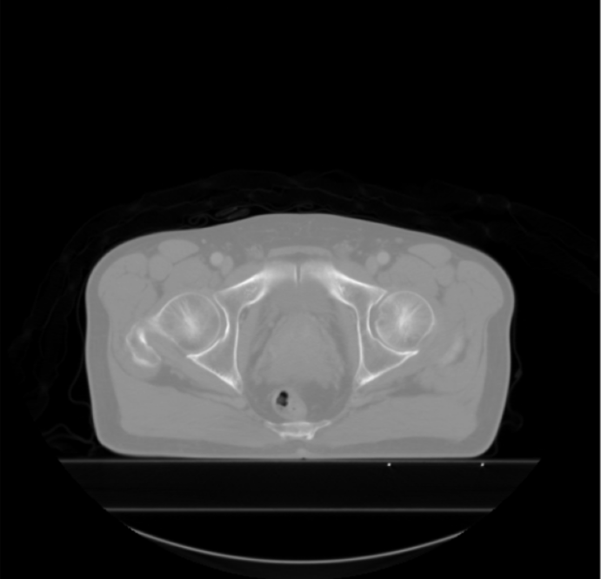
Read Registrated Dicom file
Use pydicom

Slide 22
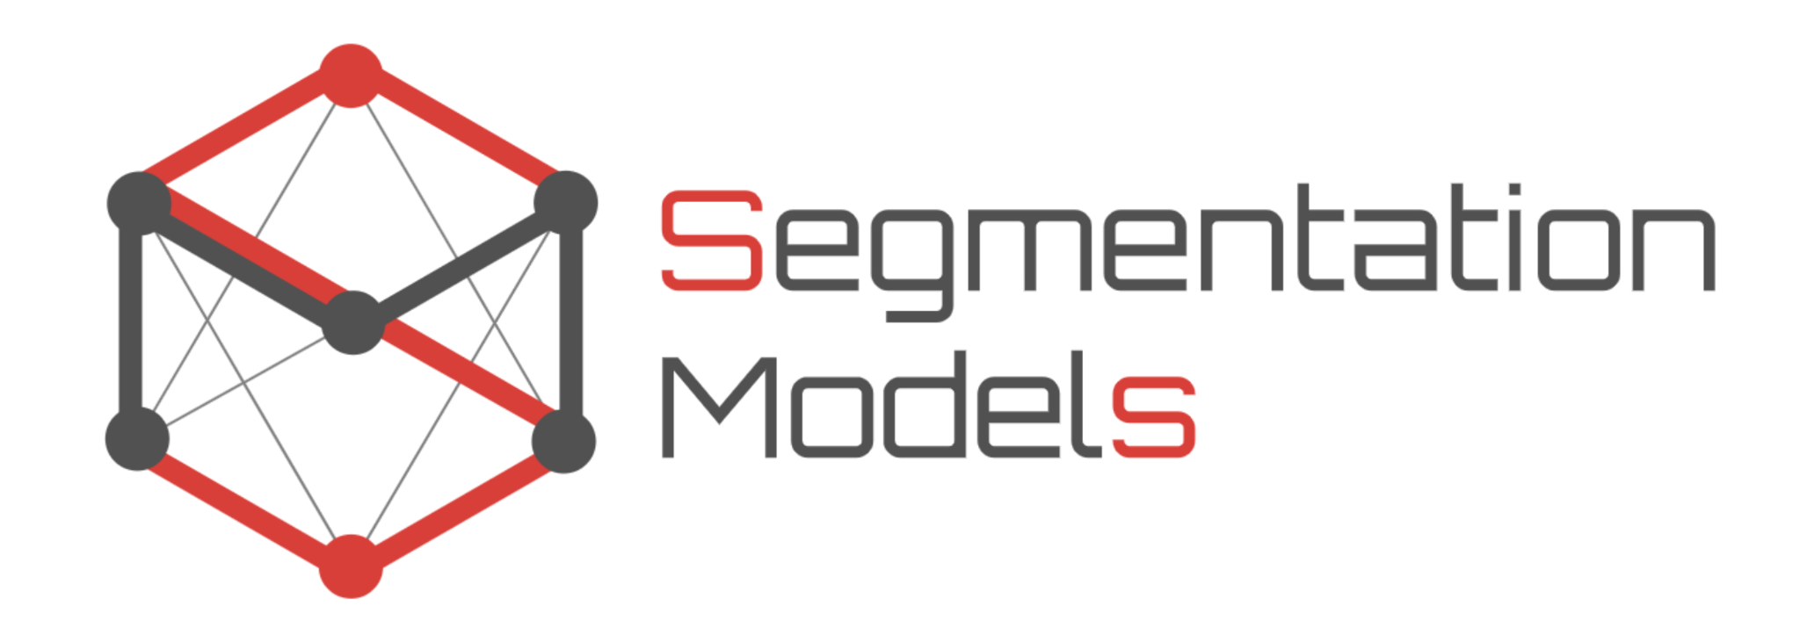
Training
Model:
UNet
Loss: Mean Absolute Error
Evaluation: 1. MAE
2. Signal to Noise Ratio
3. Structrual Similarity

Slide 23
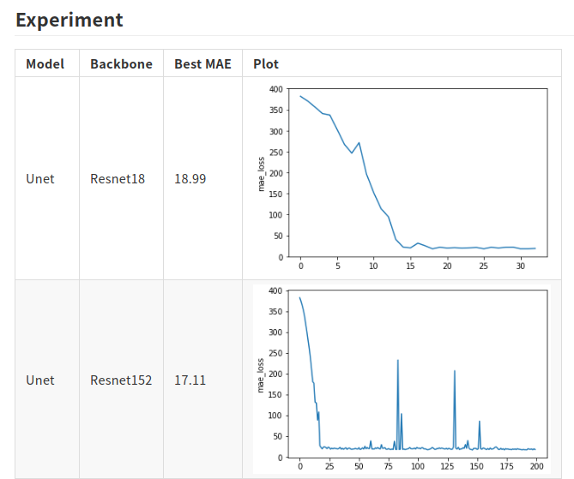
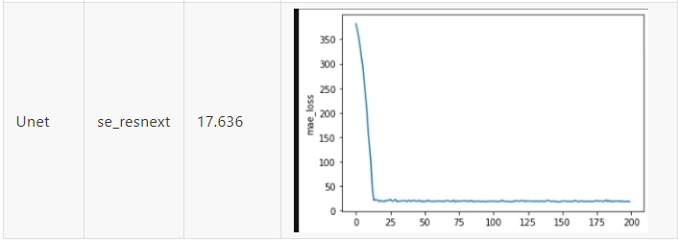
Training :

Slide 24
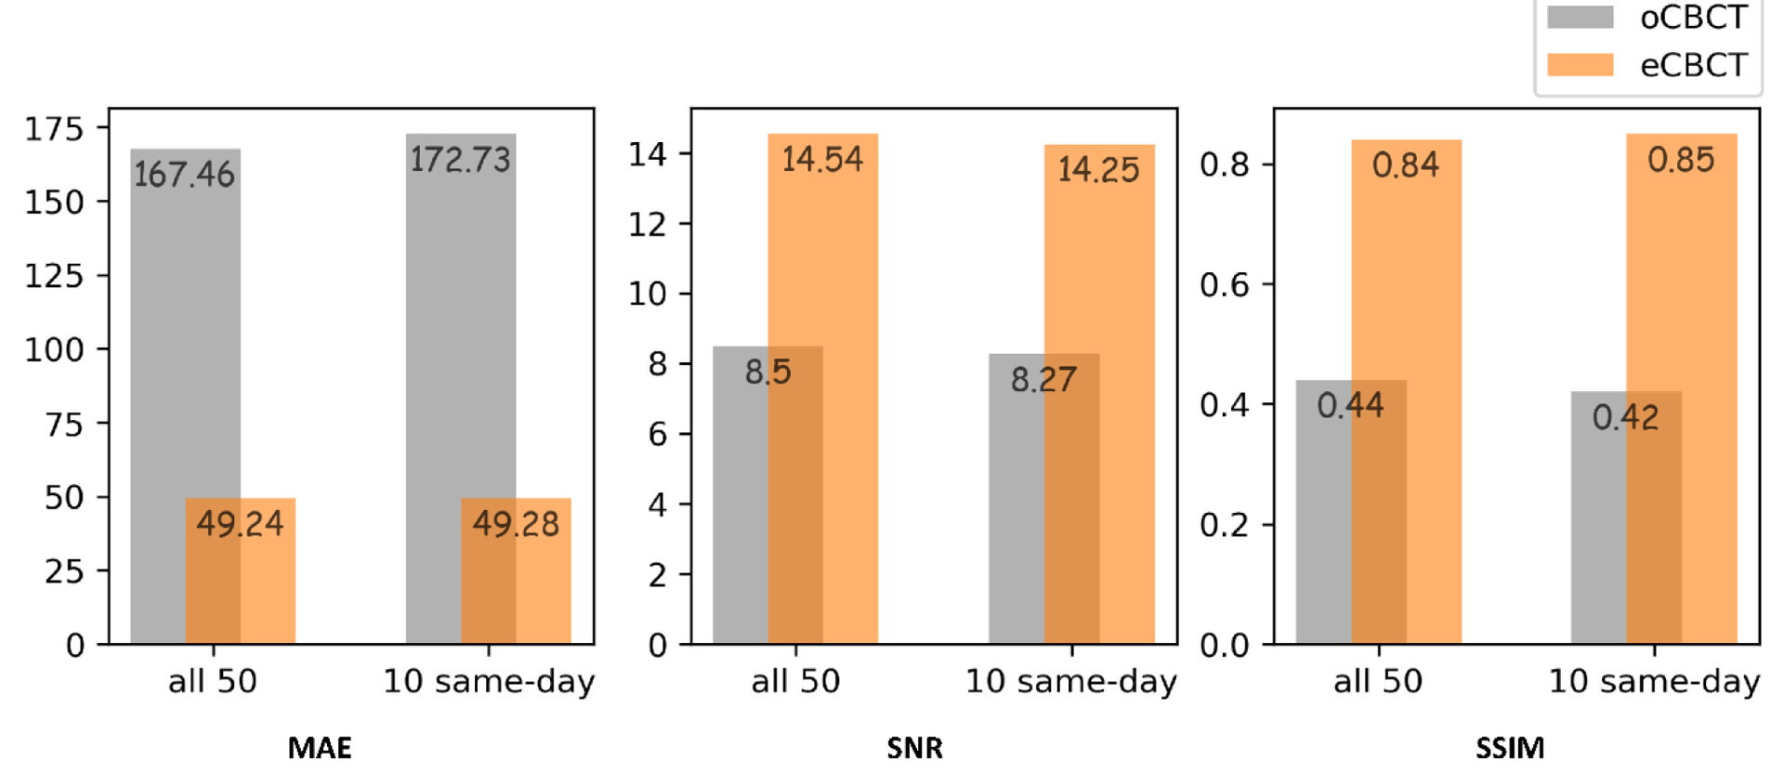
Final Model :
Unet with Resnet152 as Backbone
MAE | SNR | SSIM
16.506871957429414 | 17.051995686835642 | 0.7123112759665045
Our Result
b) Result of reference paper

Slide 25
Example
Pros:
Artifact Correction:
Bone or metal: beam hardening
streak and dark bands
metal artifact/high-density foreign material artifact
Cons
Inaccurate abdominal/pelvic soft tissue position
Better MAE and SNR but lower SSIM compare to head and neck cancer eCBCT result

Slide 26
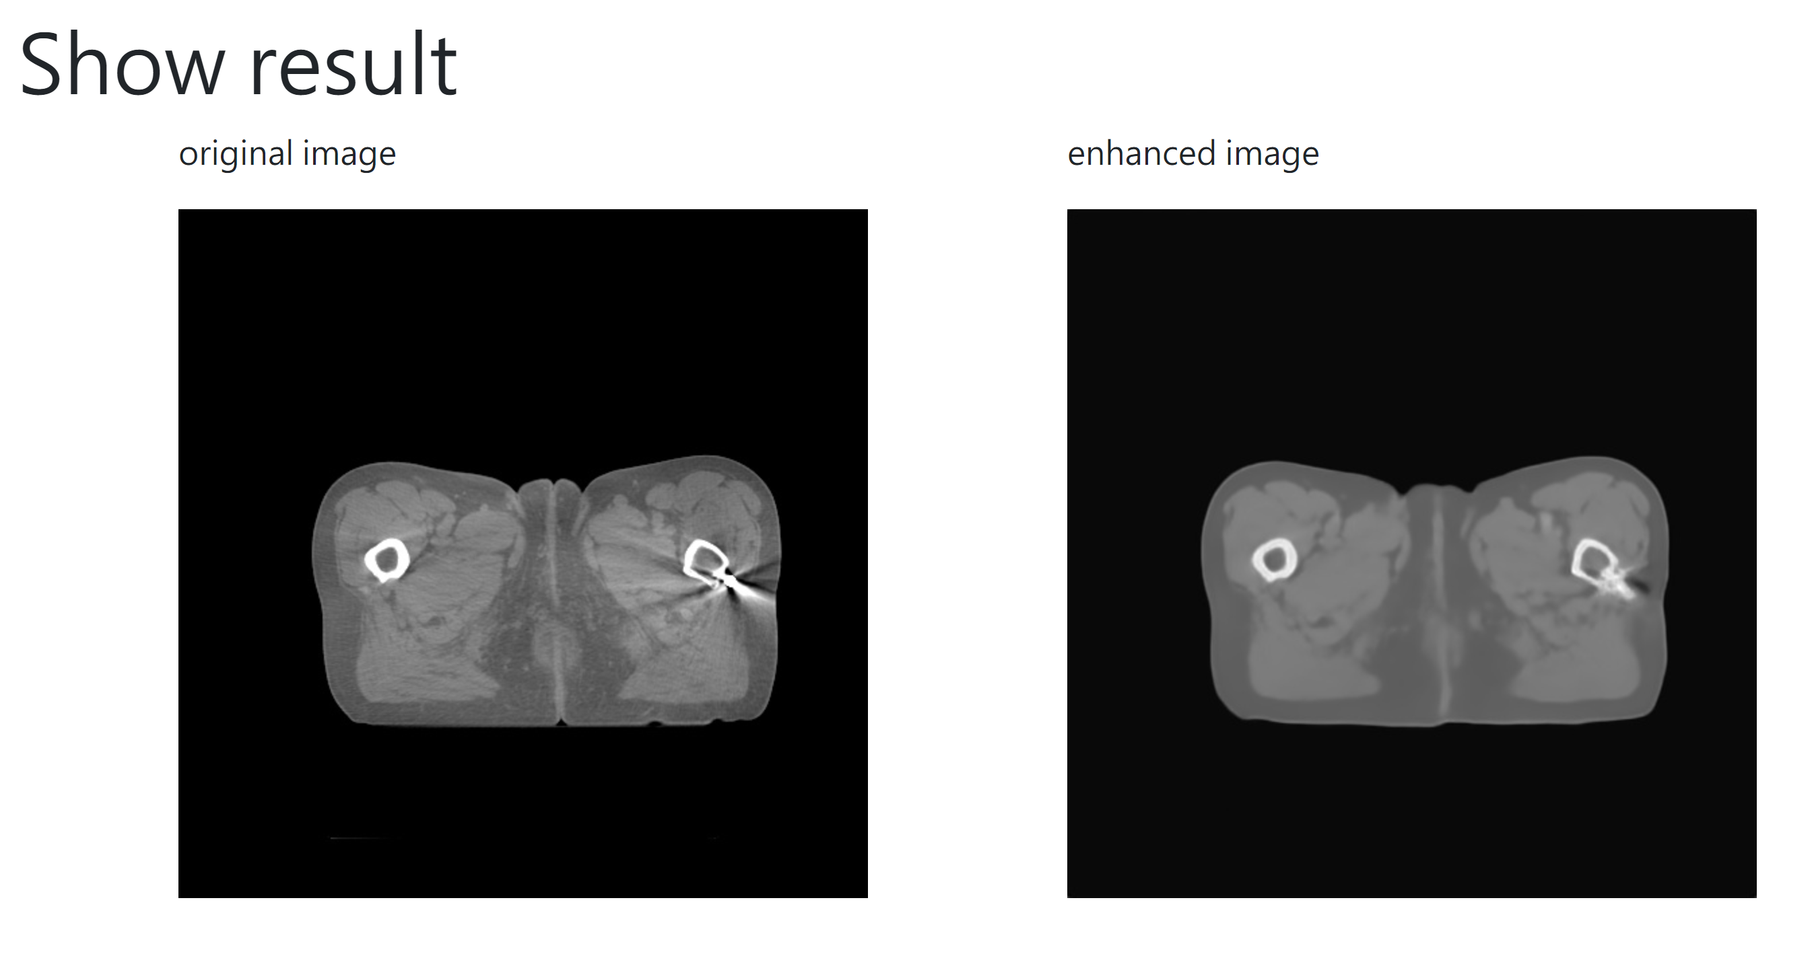
Notes:
014

Slide 27
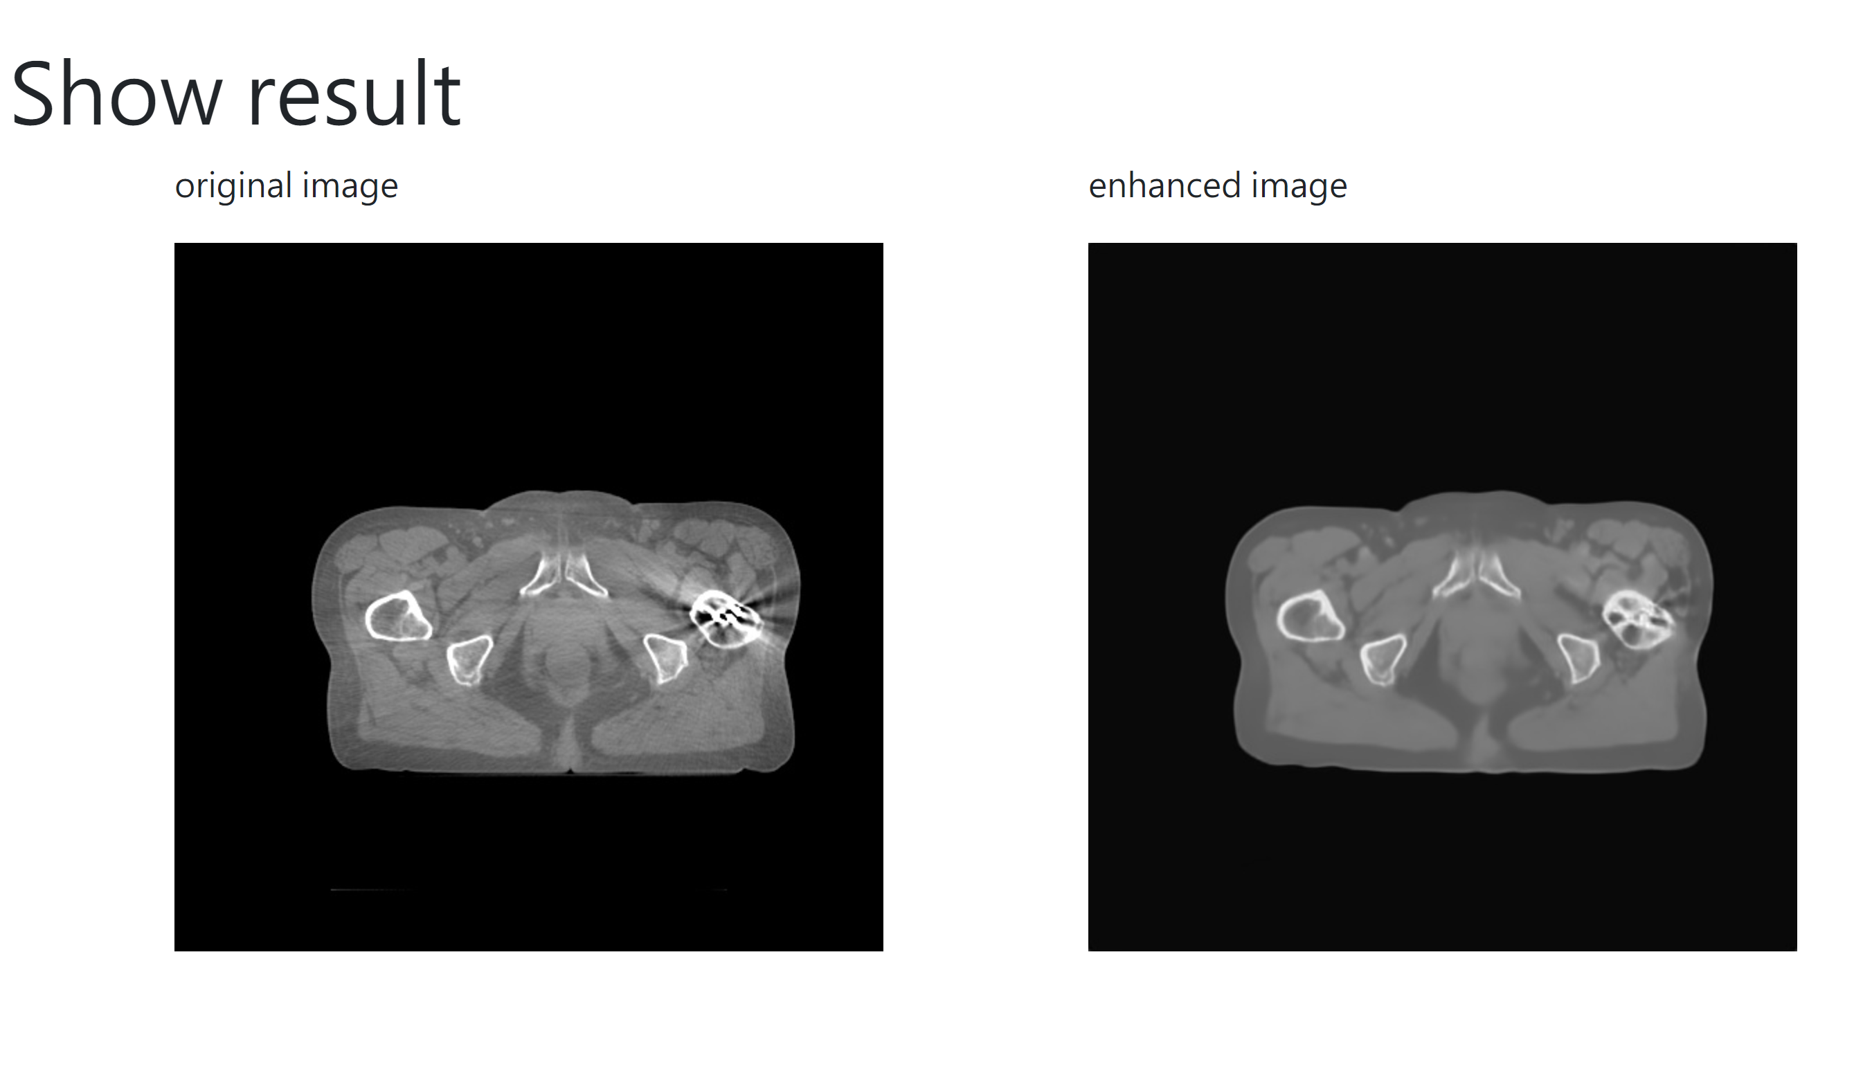

Slide 28
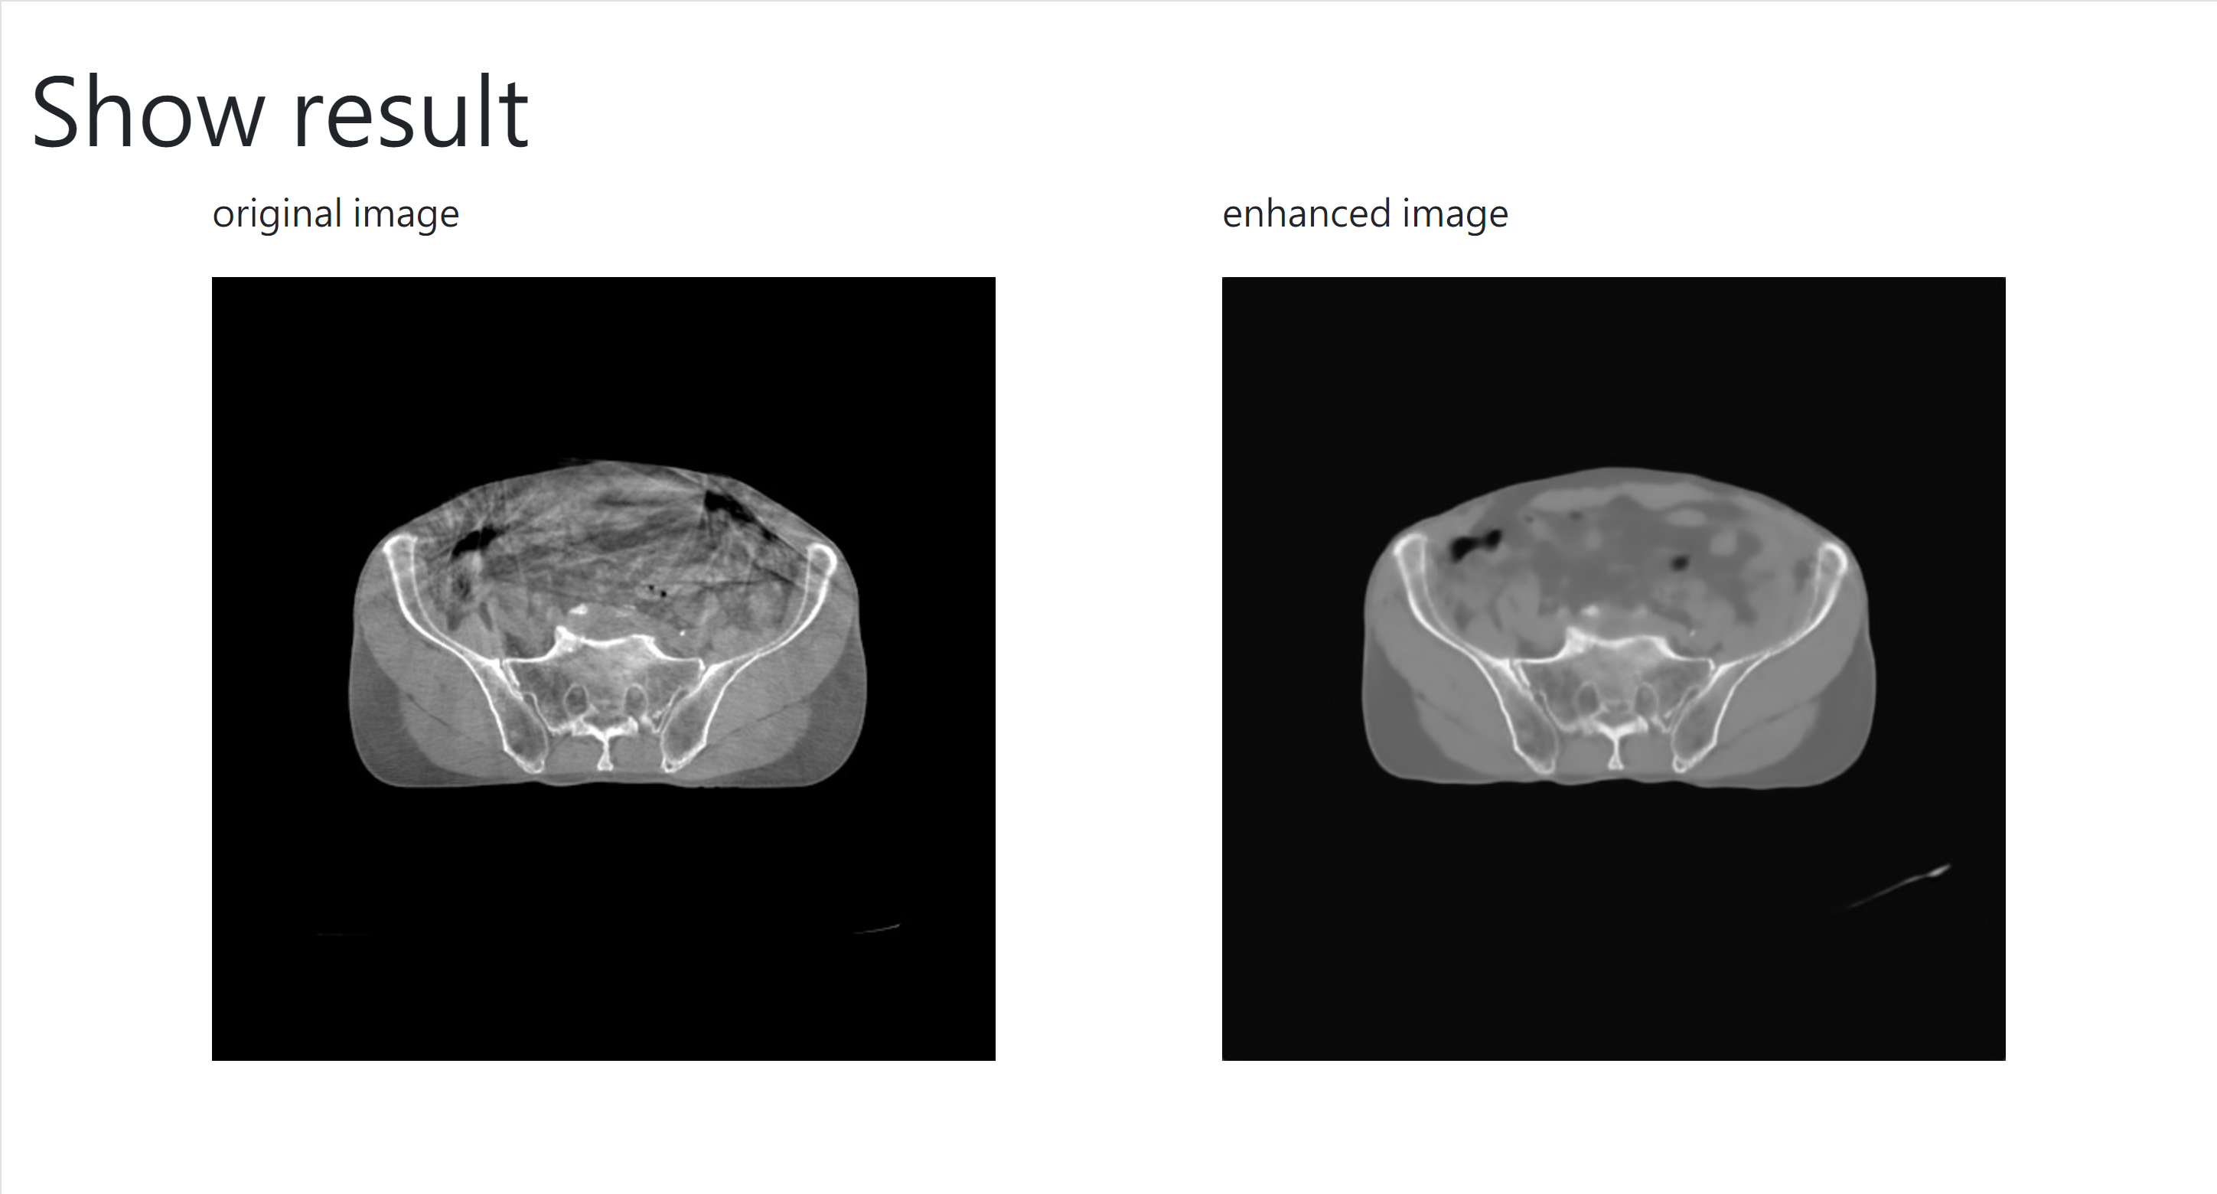

Slide 29


Slide 30
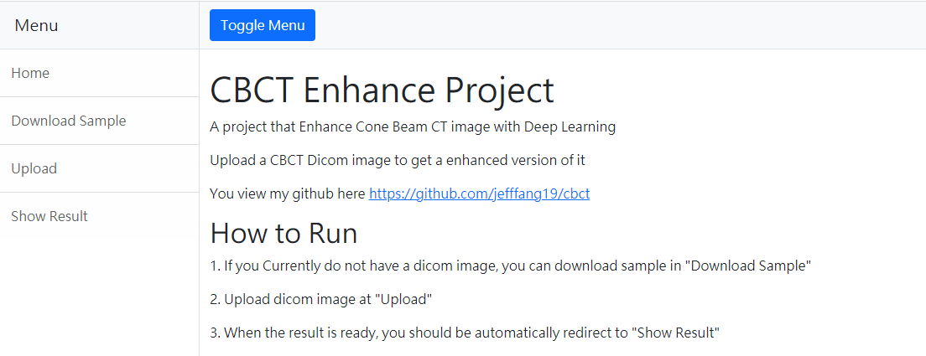
Testing Website
http://140.116.247.177:5757/run_model/
Future work: CycleGAN or other models

Slide 31
Checkpoints
Data Collect
Image Registration
Discuss about preprocessing (which window size)
Train Model with registered Images
Evaluation Metrics
Discuss with Doctor about the result
Host a server for this system

